Slide 1
Dirty COW

Slide 2
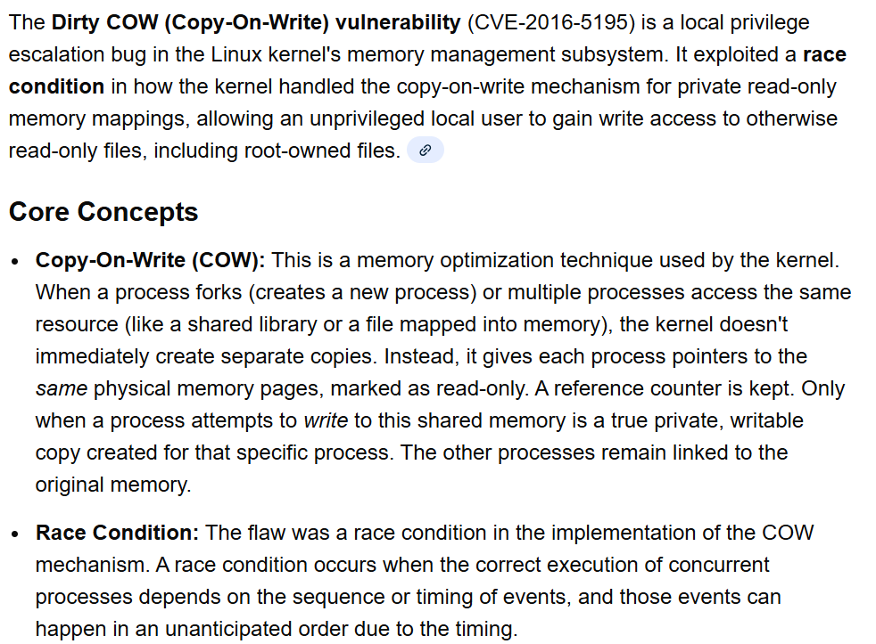

Slide 3
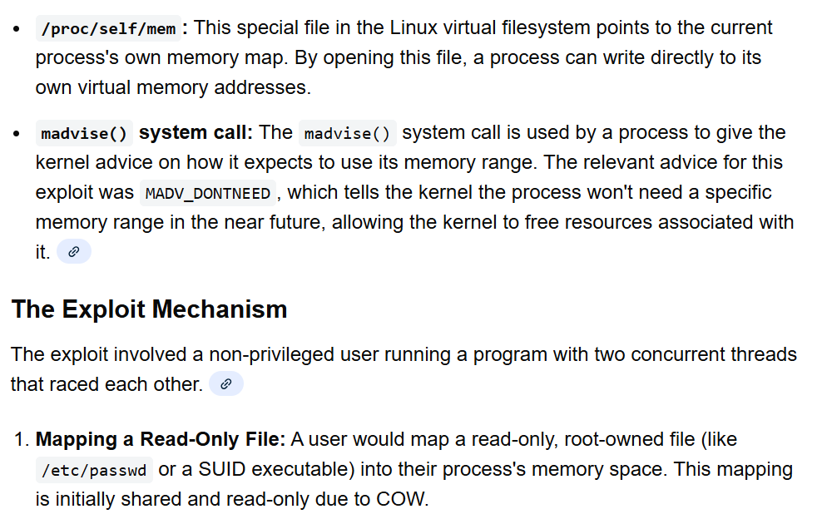

Slide 4
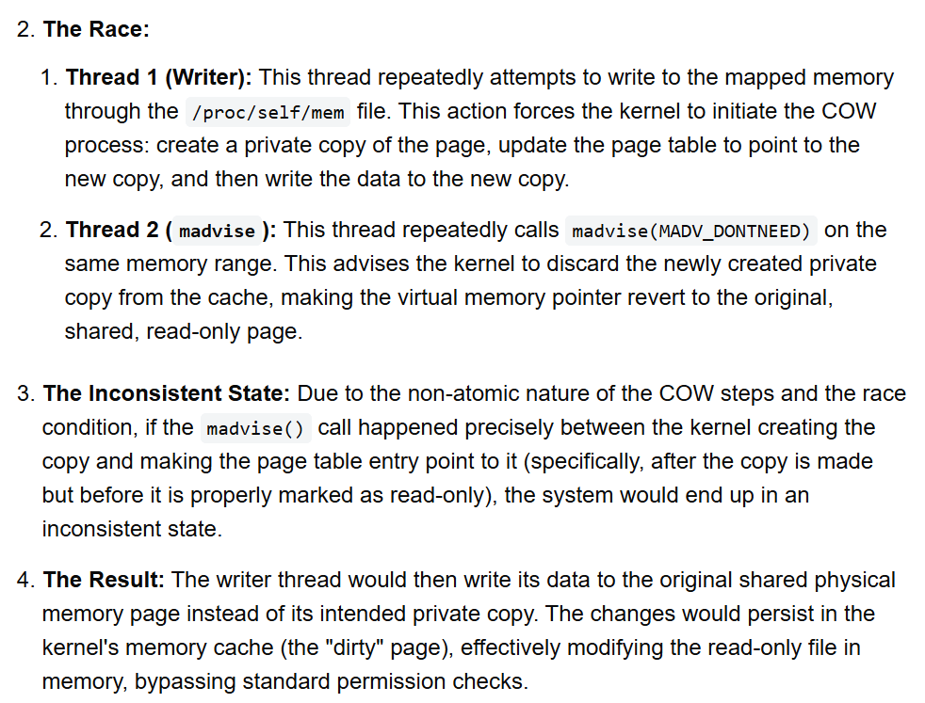

Slide 5
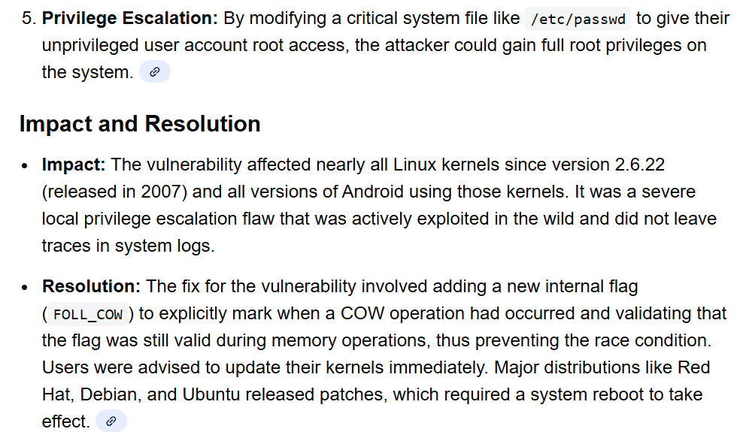

Slide 6
Thank you
Dr. Rachaita Dutta
Assistant professor
Dept. of mca
  9007223301
  rachaitadutta@my.amrita.edu

